Slide 1

OPPSKALERING AV WORKSHOPS PÅ BEST PRAKSIS AV DATA SCIENCE OG FORSKNINGS PROGRAMVAREUTVIKLING - HVORDAN KAN DE NÅ DE SOM TRENGER?
Naoe Tatara, PhD
UiO Universitetsbibioteket, Bibliotek for medisin og realfag
Digital Scholarship Center
Regional Coordinator of the Carpentries and CodeRefinery in Nordic countries

Slide 2
Goals of this presentation
Sharing experiences on large scaled workshops
Dissemination of opportunities that national universities in Nordic countries can take advantage of regarding the Carpentries and CodeRefinery

Slide 3

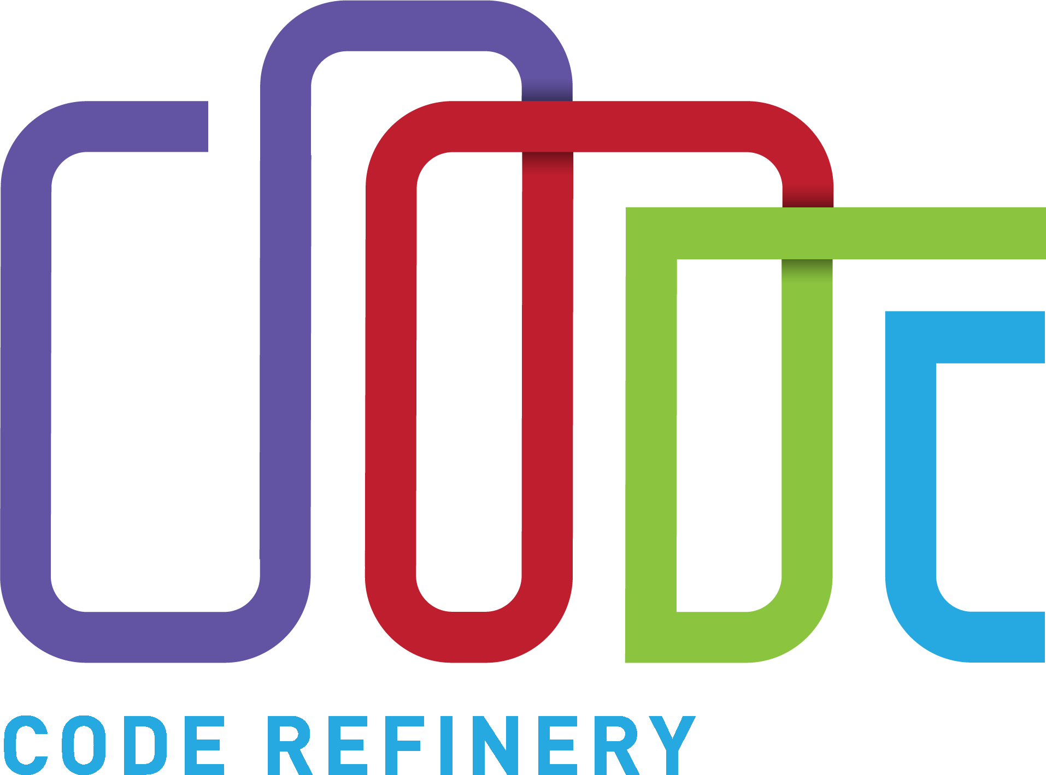
Questions
Hvordan ble workshops kjennetegnet av mye live-coding med hands-on vellykket med oppskalering ved å beholde det så inklusive som fysiske workshops?
Og hvordan kan de skalere opp enda mer og nå de som trenger det?

Slide 4
What are common?
live-coding
hands-on
inclusive
Size (ca. 30)
CC-BY lessons

Slide 5
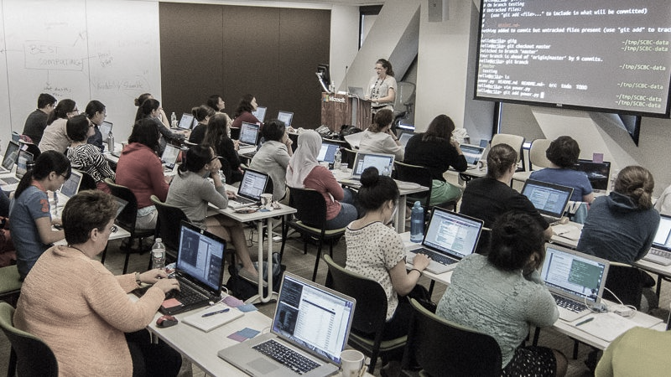
Instructor is live-coding
Learners are type along
This Photo by Terri Yu, 2016 is licensed under CC BY-SA

Slide 6
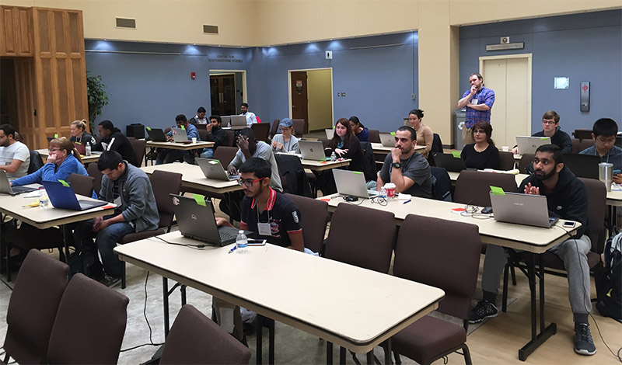
Helper provides immediate help
Learners use stickers to indicate status
This Photo by UTA Libraries is licensed under CC BY-NC

Slide 7
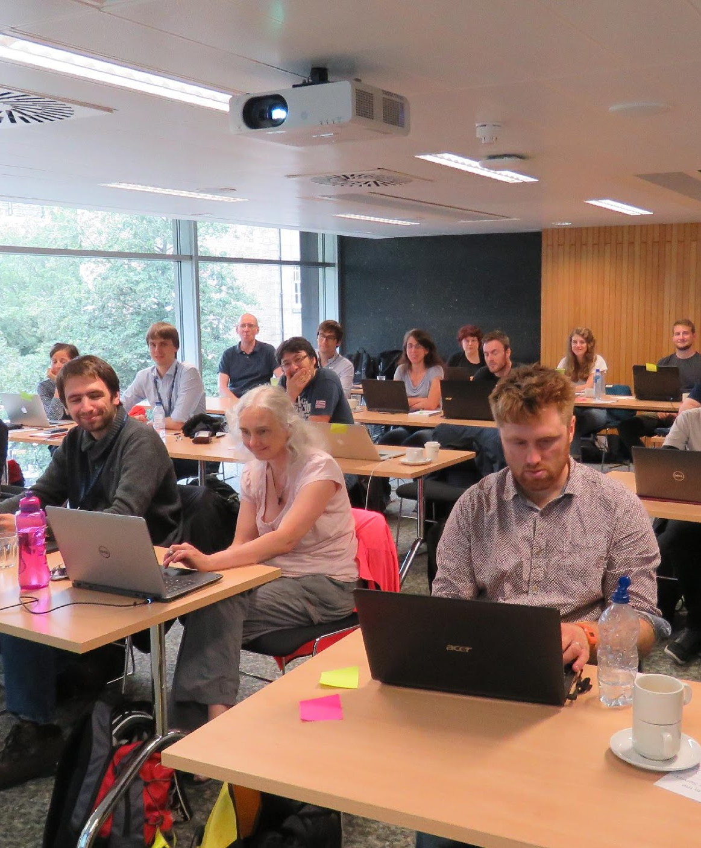
Code of conduct
Use welcoming and inclusive language
Be respectful of different viewpoints and experiences
Gracefully accept constructive criticism
Focus on what is best for the community
Show courtesy and respect towards other community members
The Carpentries CC-BY
This Photo by Robin Rice, 2016 is licensed under CC BY

Slide 8
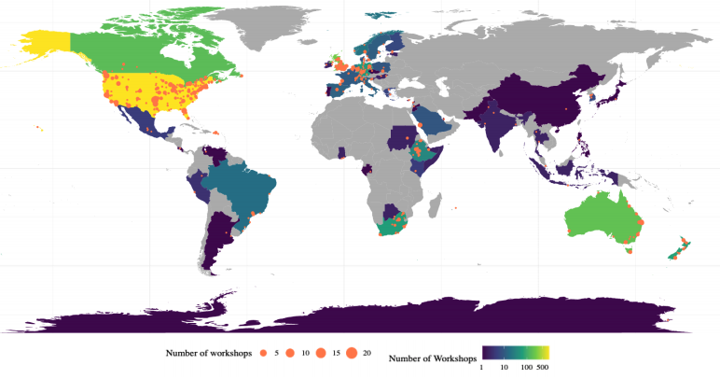

The Carpentries (Workshops)
Teaching foundational coding and data science skills to researchers worldwide (novice)
Global community of like-minded volunteers of different roles. (e.g. 3000+ instructors, helpers, lesson maintainers, instructor trainers, etc.)
Centrally-Organized and Self-Organized workshops
The Carpentries CC-BY

Slide 9
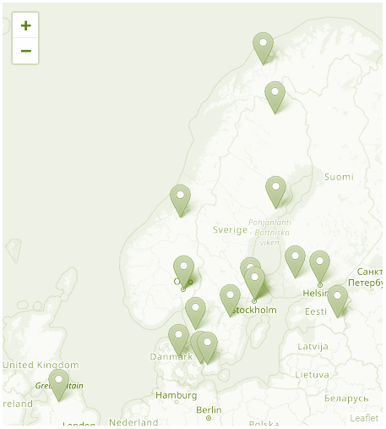
CodeRefinery (Workshops)
Training to advance FAIRness of software management and development practices
(pre-pandemic) Mainly 3-full day workshops at each training hub in Nordic countries by project staff
Funded by NeIC and national infra providers
As a project, a platinum member of the Carpentries providing opportunities to National univ. in Nordics
CodeRefinerys CC-BY

Slide 10

SHIFT TO ONLINE IN 2020
Carpentries recommended small-sized workshop with around 12-15, max 20 learners.
CodeRefinery envisioned large-sized workshop, aimed to reach >100 learners.
3 big online CodeRefinery workshops (May-June, October, and November 2020)
Up to around 100 participants (helpers and learners)
Piloting diverse cross-organizational workshops
Upcoming workshop in May: 200+ sign ups
This Photo by Paul Hollowayr is licensed under CC BY-SA

Slide 11






How CodeRefinery workshops scaled up
LECTURES & CODE-ALONG EXERCISES IN THE MAIN ROOM
COLLABORATIVE NOTE FOR IMMEDIATE Q&A
GET HELP AND DO GROUP EXERCISES IN A BREAKOUT ROOM
HIERARCHICAL STRUCTURE AND HELPER TRAINING
“BRING YOUR OWN BREAKOUT ROOM”
STREAMING AND VIDEO ARCHIVE

Slide 12
Lectures & code-along exercises in the main room
Short lectures to explain a concept
Demonstrate the concept on a very short example (and often repeat explanation)
Frequent check-in: understanding and speed
Flexible choice of code-along or demonstration

Slide 13



Collaborative note for immediate Q&A
HackMD/CodiMD – quite robust for 50-100 active editors
Interactive Q&A during the main room session
Safer way to ask questions anonymously
Index where we are right now, links to lessons
Archived note for reviewing

Slide 14
Get help and do group exercises in a breakout room
Exercises to try concepts previously taught to check understanding
Pre-defined and fixed breakout rooms with 3 to 10 people in each
Interactive learning process
Post-session debriefing or continuation on exercise on each day

Slide 15
Hierarchical structure and helper training
Helpers
They don’t have to know “everything”
Helper onboarding in advance (Code of Conduct)
They can call in other helpers
Expert helpers
They support helpers on demand
They cycle between breakout rooms

Slide 16

“Bring your own breakout room”
Learners could register as a team (3-10 persons) with their own helper(s)
The team worked together in a same break-out room
The helpers were very often someone who already attended a CodeRefinery in-person workshop, or someone in charge of technical support for the team

Slide 17
Streaming and video archive
Twitch platform for streaming (from Zoom streaming or OBS)
Affording learners who wanted to be rather viewers than active doers
Online collaborative note and Twitch chat used for interaction with Twitch viewers
Stereamed videos automatically archived and available for 14 days

Slide 18

Positive outcomes of this strategy
Open and equal opportunity to participate in the workshop regardless of location
Engagement by more volunteer helpers and instructors – Community building
Team participation, team building
Easier time management of workshops
Effective team work leading to less workload and flexibility for project staff

Slide 19

Is it applicable to Carpentries workshop?
Piloted at UiO with "Plotting and programming with Python" lesson
3 instructors and 10 helpers
12 Break-Out rooms (inc. 3 teams) with 39 learners in total

Slide 20




Learners’ feedback
Appreciation for helpers
Well organized
Knowledgeful and skillful instructors
More time on exercise

Slide 21

TAKE ADVANTAGE OF THE CARPENTRIES AND CODEREFINERY

Slide 22
The Carpentries workshops and instructor training using Platinum member benefits
Requesting Centrally-Organized workshops without or with discount administrative fee
Taking the Carpentries instructor training to be certified instructor
Self-Organizing workshops with certified instructors at your institute or in collaboration with other institutes

Slide 23
CodeRefinery workshops
Online workshops are open and free for all and students/staff at national universities/research institutes in Nordic countries are prioritized.
Team registrations are always welcome and most likely accepted.

Slide 24

For more info
carpentries.org
coderefinery.org
Take contact: naoe.tatara@ub.uio.no

Slide 25
The Carpentries (Lesson programs)
Modular curriculum with 3 distinct sections and 1 optional for more effective programming
Domain specific curriculum centered around a single dataset
For people in library and information related roles with domain specific focus

Slide 26

CodeRefinery (Lessons)
Introduction to version control
Collaborative distributed version control
Reproducible research and FAIR data
Social coding and open software
Documentation
Jupyter
Automated testing
Modular code development
This Photo by Unknown Author is licensed under CC BY-SA-NC

Slide 27
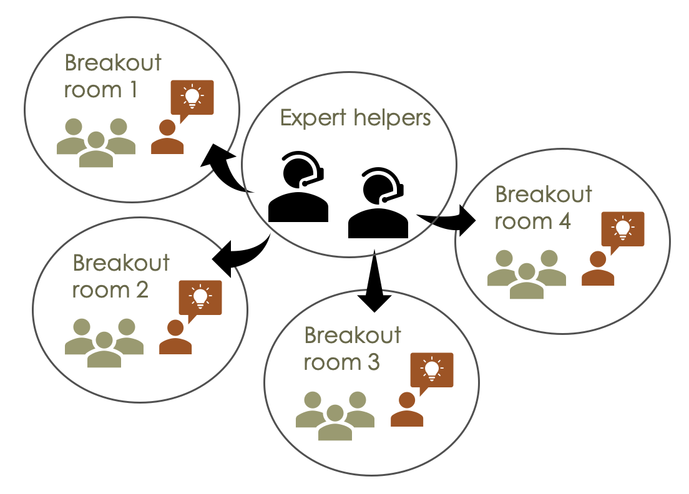
Hierarchical structure and helper training

